Slide 1
UNIT I – BASICS OF SDN
UNIT I – SESSION 1
SESSION 6
Distributed Control Planes- IP and MPLS :
Creating the IP Underlay, Convergence Time
Load Balancing ,High Availability
Creating the MPLS Overlay
Replication
Reference: Ref. 2, Ch.2 (Page. 28 to Page 37

Slide 2
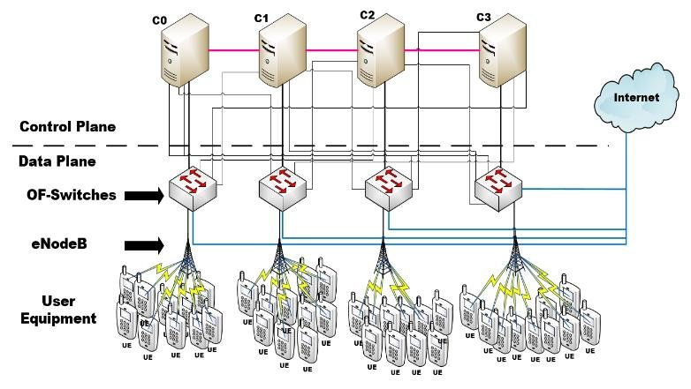
Distributed Control Planes
Distributed control plane means that control plane of all networking devices lies within the device itself.
Each device have their own control plane to control data plane.
Each controller manages a subset of the network switches, Distributed control planes can handle larger networks .
When a change occurs in the network (e.g., a link failure or a new device joining), the controller managing the affected part of the network detects this change.
The local controller updates its state and communicates this change to other controllers. This communication can be done using protocols designed for distributed systems,

Slide 3
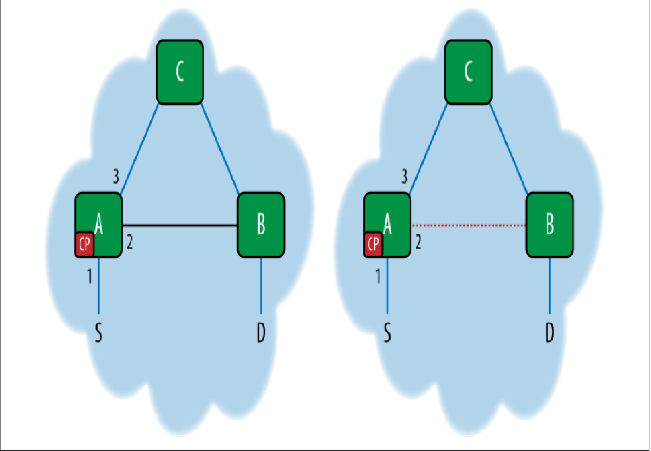
1.Distributed Control Planes-eventual consensus
The control paradigm that has evolved with the Internet, which is our ultimate network scale problem to date, is a distributed, eventual consensus model.
In this model, the individual elements or their proxies participate together to distribute reachability information in order to develop a localized view of a consistent, loop-free network. We label the model as one of eventual consensus because of the propagation delays of reachability updates
By design, the model is of intermittent nonsynchronization that could lead to less optimal forwarding paths but (hopefully) avoiding or limiting transient cycles otherwise known as micro-loops in the overall path.
Observe the network on the left represented by the cloud and three nodes (A, B, and C). At time = 0, the network state is inconsistent and exhibiting a looping network. In this case, packets could cycle if transmitted, as the forwarding at nodes A and B are allowing traffic to flow between them.
However, at time = 1, represented by the cloud on the right of the figure, the link between nodes A and B is broken. This represents the eventual consistency concept whereby the network, for a fraction of a second in time, could remain unstable until the routing message updates are exchanged between the nodes in the network.

Slide 4
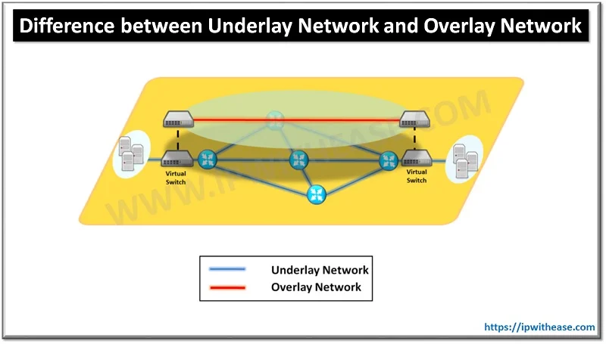
IP and MPLS
https://www.youtube.com/watch?v=4_PsxbY-qB4
IP and MPLS forwarding are examples of a distributed control model.
IP MPLS stands for Internet Protocol Multi-Protocol Label Switching. IP MPLS is a routing system that enables fast data switching from one node to the next based on labels
In these forwarding paradigms, routes and reachability information is exchanged that later results in data plane paths being programmed to realize those paths.
An Overlay Network is a virtual network that is built on top of underlying network infrastructure (Underlay Network). Actually, “Underlay” provides a “service” to the overlay
Underlay Network is physical infrastructure above which overlay network is built. It is the underlying network responsible for delivery of packets across networks.

Slide 5
1.1.Creating the IP Underlay
The foundation of the current IP control plane paradigm is to use an IGP. This normally is in the form of a link-state protocol such as OSPF or ISIS. The IGP is used to establish reachability between a connected, acyclic graph of IP forwarding elements.
Once configured, IGP protocols establish relationships with appropriately configured neighbors and manage control protocol sessions that exchange reachability information (i.e., NLRI or route state)
The network elements participating in this exchange store the accumulated advertisements from other nodes in a state database (e.g., OSPF database) and run a shortest path algorithm against that data to establish a self-centered reachability graph of best paths to destinations. These best paths are contributed to the RIB
Scale of the control plane state in such networks is addressed both in physical and logical design, using the tools of recursion, summarization, route filtering, and compartmentalization (physical/logical).
To advertise reachability across administrative boundaries or to carry reachability data sets—notably, different address families that represent further abstractions like virtual private networks across a network without carrying it in the IGP—the IP control paradigm typically uses the border gateway protocol (BGP).
This information is made more accessible and scalable in both the control and data plane through recursion. Recursion allows the network control plane to distribute information with different attributes specific to different protocols that link through a series of shared keys, as shown in Figure

Slide 6
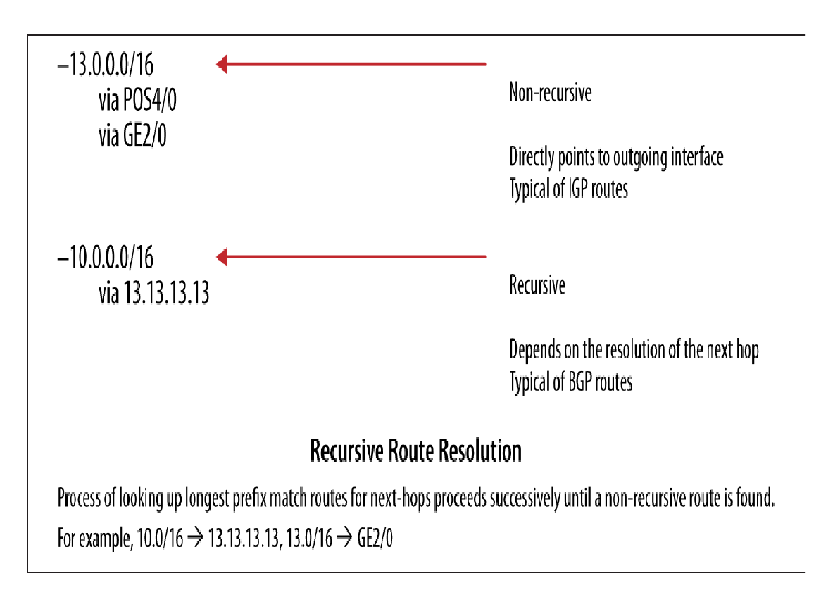
1.1.1Route recursion
Route recursion is the simple process that all routers complete to find out what interface to use when routing to a particular prefix
In the data plane, this recursion ultimately resolves the BGP prefix via the IGP “next hop” to a pointer to a fully qualified adjacency for the layer 2 components of a forwarding entry.
This forwarding entry ultimately represents a destination MAC entry for the next router/switch interface in the path.

Slide 7
1.1.2.Convergence Time
The FIB (or the data plane forwarding state entries) in the IP model has undergone years of optimization of both structure and traversal (lookup) algorithm. In this model, convergence and load balancing are as important focal points for network operators/ designers
Convergence is the time it takes from when a network element introduces a change in reachability of a destination due to a network event to when this change is seen and instantiated by all other relevant network elements.
One of the components of convergence -propagation delay of a specific update. This is a function of the average distance from the site of first change measured and number of intervening nodes that have to re-flood/re-advertise the update.
The remaining components of convergence delay -the processing of the update locally, such as updating the RIB and instantiation in the data plane which includes updating the FIB

Slide 8
To optimize convergence processing at the protocol level, as well as the propagation/ flooding mechanism, each protocol has a different internal timer that is used to generate various types of events for that protocol. This includes, for example, the generation of “hello” messages to neighbors.
To optimize the updates to the FIB, different vendors have developed table organization strategies and event-driven reaction strategies for key components of the recursive nature of the FIB (e.g., the BGP next hop). These optimizations minimize the number and type of changes to the FIB that happen in response to a network event and thus minimize convergence.

Slide 9
1.1.3.Load Balancing
Load balancing in distributed IP forwarding evolved from packet-by-packet processing to hashes of increasingly greater parts of the IP header.
This occurred as a reaction to the extent to which more and more individual flows began to be represented by gateway devices, such as those used for voice and other media.
Efficiency of a load balancing algorithm is bounded by both the computation algorithm itself, as well as the potential imbalances in flow size an implementation might encounter

Slide 10
1.1..4.High Availability
High Availability in the distributed IP context is provided through several mechanisms:
• Redundancy at the network level (the “two of everything” approach, where redundant routers/switches and redundant paths in the network design allow for the failure of a link or element).
• Redundancy at the element level using redundant route processors/switch control modules. The redundant processors can work in either a stateless active/standby mode (which normally implies an interruption in forwarding if there is no alternative path) or through stateful mirroring of control process data (e.g., nonstop routing).

Slide 11
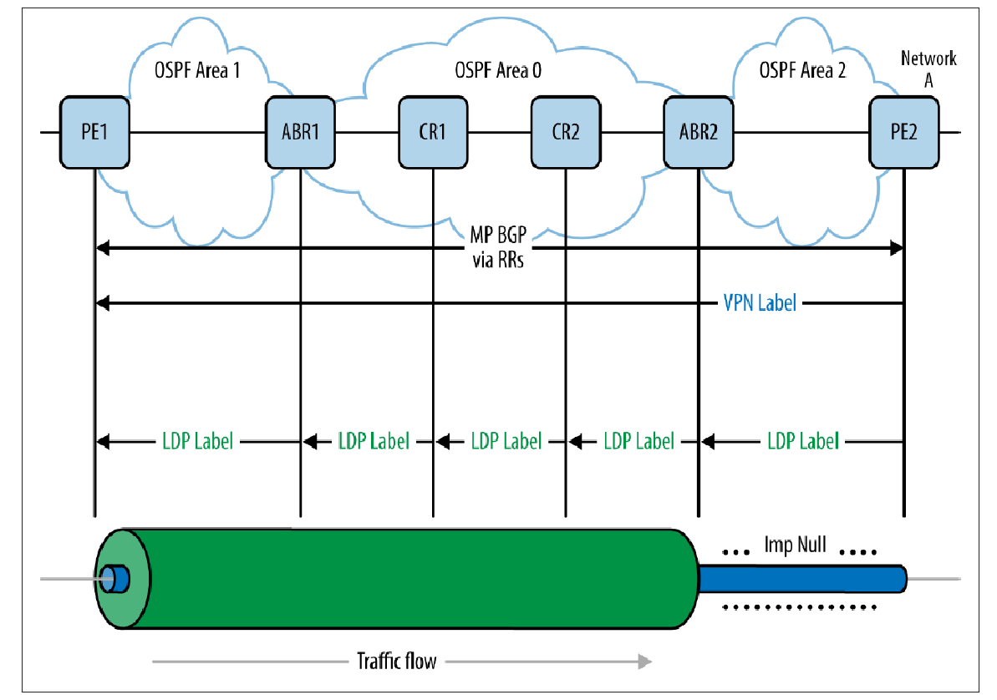
1.2.Creating the MPLS Overlay
In terms of a discussion of SDN, MPLS is an addition to the packet header—an encapsulation that allows the operator of an IP network to create overlays or logical tunnels on the IP network (the underlay), as shown in Figure
https://www.youtube.com/watch?v=rdl-eyLIGJE
An MPLS VPN (VRF label distribution via route reflection) over an OSPF multiarea underlay

Slide 12
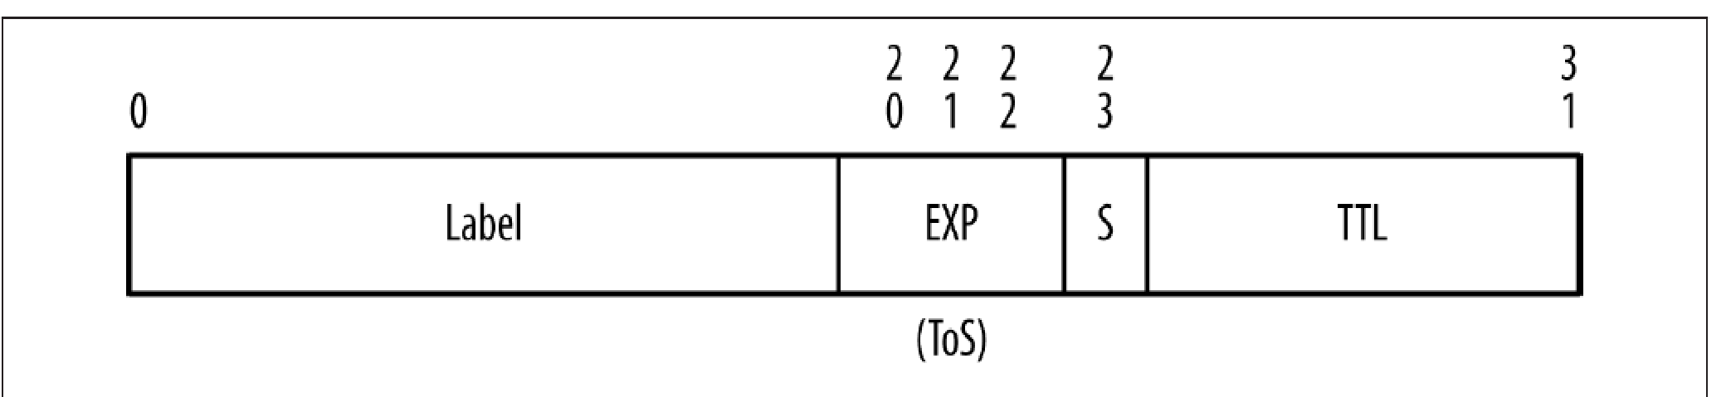
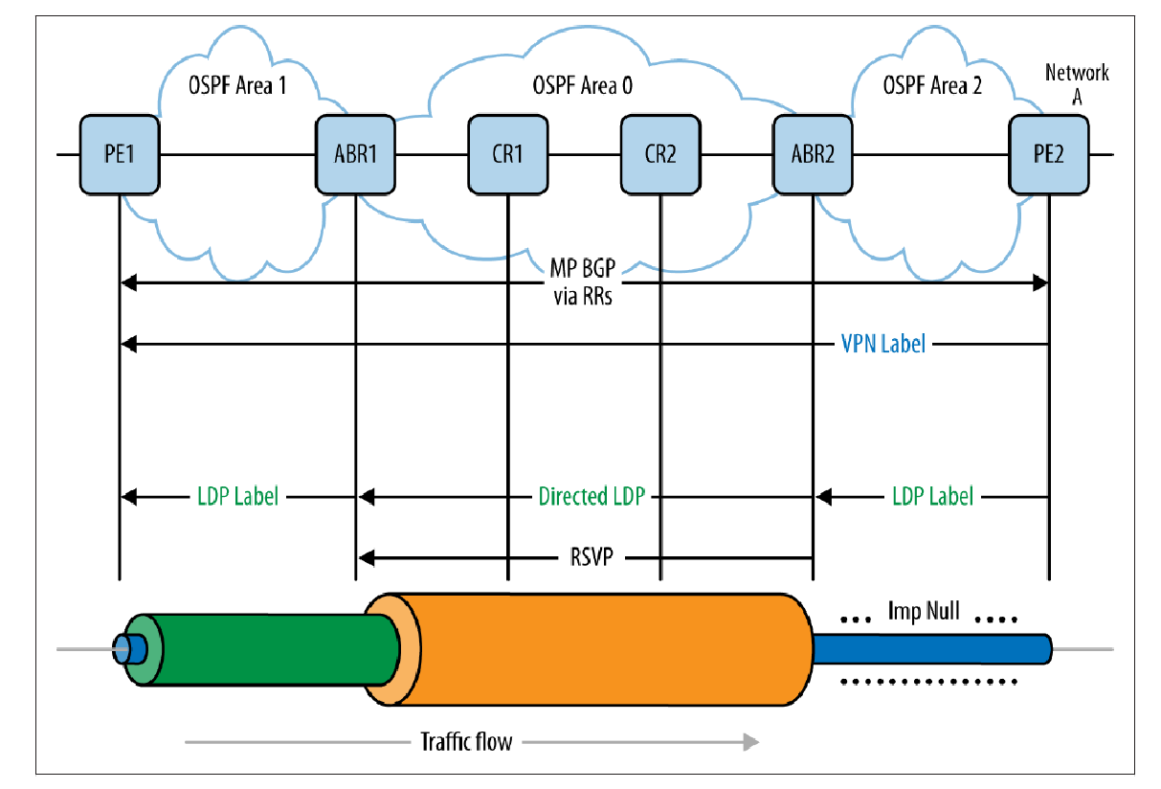
MPLS label
The label itself is 24 bits, which means there are 1,048,575 labels
Labels can be stacked in a LIFO (last in, first out) order. The stacking of labels allows for the creation of multiple services or tunnels across a network. These were precursors to today’s network overlays.
• A single label can enable an expedited lookup in the label table versus the IP forwarding table.
• Two labels create an abstraction that enables isolation, like that of the VPN where the external label expedites forwarding to an element with multiple virtual instances (VRFs) whose discriminator is the inner label as shown in Figure
• Three or four labels create abstractions that enable the same forwarding through an intervening tunnel (unprotected or protected), like VPNs constructed over traffic engineering tunnels (with or without fast reroute protection).
An MPLS VPN (VRF label distribution via route reflection) over an MPLS TE core (all over an OSPF underlay
https://www.youtube.com/watch?v=Gvy7XSF4IiM&t=234s

Slide 13
The main aspects of MPLS operation involve label allocation, address binding, and label distribution—all of which are controlled by configuration:
• The label distribution protocols can be LDP, RSVP(Resource Reservation Protocol) (and BGP for the labeled unicast address family). These control protocols have neighbor/session forming behaviors and information exchange.
• Label allocation is normally dynamic, but label scale can be controlled somewhat in some vendor implementations particularly in the context of VPNs by per-VRF allocation or per-prefix/per-platform allocation. The assignment of these labels can be ordered (but this is not a requirement).
• Label distribution can be downstream on-demand (e.g., RSVP for traffic engineering) or downstream unsolicited which is the default behavior of LDP.
When MPLS is deployed, the forwarding behavior of the data plane changes from longest destination prefix match to a match of the topmost label on the label stack.
The specific application of MPLS traffic-engineered tunnels allows the operator to control the path of tunnels and thus exploit areas of the network not used for ordinary destination prefix-based forwarding
https://www.youtube.com/watch?v=N4gue7bGInY
https://www.youtube.com/watch?v=dAvMVW5CoMM

Slide 14
Replication-Multicasting
Both IP and MPLS distributed control apply equally to unicast and multicast, though they both require unique protocols and data structures for multicast replication
Multicast replication has a fairly long history in IP-only networks, starting with DVMRP(Distance Vector Multicast Routing Protocol ), then MOSPF(Multicast Open Shortest Path First ), and evolving to PIM(Protocol-Independent Multicast). In MPLS networks, there have been recent developments around multicast in the VPN context (MVPN)
The multicast control protocols optimize around scale, convergence, and stability, as well as strive to avoid black holes and cycle/loops. In the case of MVPN, there are additional concerns about balancing multicast state in the network with the burden of replicating packets on elements at the edge of the network.

